Slide 1
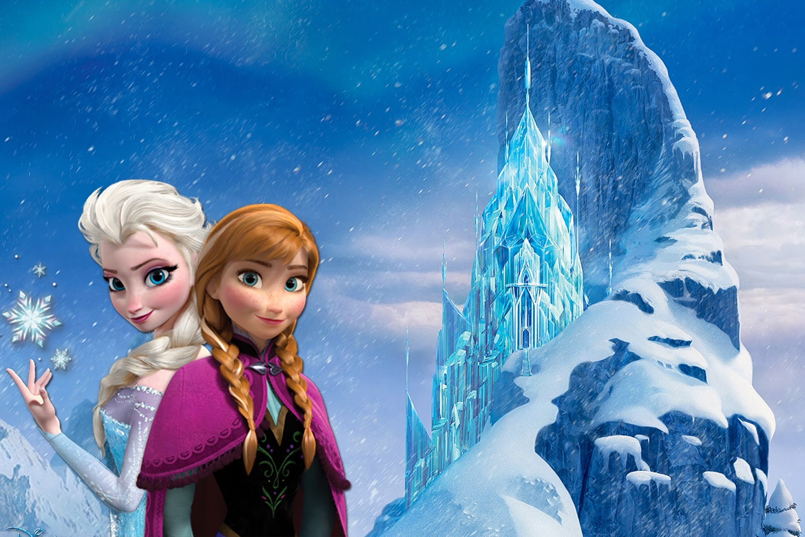

Animation
CS Bridge
July 6, 2021

Slide 2

Learning Goals
Feel more confident debugging
Write animated programs

Slide 3
You will be able to write Bouncing Ball

Slide 4
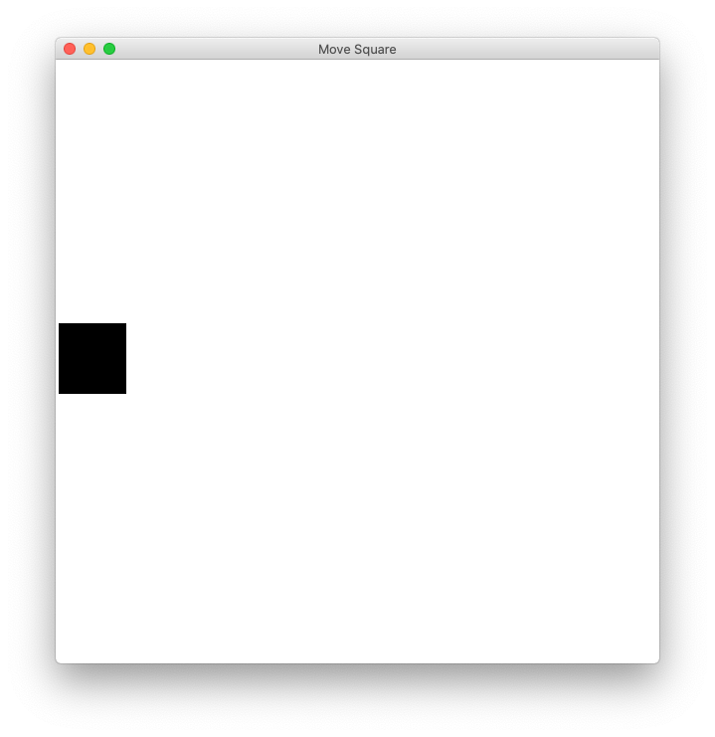
Move to Center

Slide 5
In our last episode...

Slide 6
Graphics from tkinter (aka tk)
from graphics import Canvas

Slide 7
Add square

Slide 8
def main(): canvas = Canvas(CANVAS_WIDTH, CANVAS_HEIGHT) start_y = CANVAS_HEIGHT / 2 - SQUARE_SIZE / 2 end_y = start_y + SQUARE_SIZE rect = canvas.create_rectangle(0, start_y, SQUARE_SIZE, end_y) canvas.set_color('black') canvas.mainloop()

Slide 9
def main(): canvas = Canvas(CANVAS_WIDTH, CANVAS_HEIGHT) start_y = CANVAS_HEIGHT / 2 - SQUARE_SIZE / 2 end_y = start_y + SQUARE_SIZE rect = canvas.create_rectangle(0, start_y, SQUARE_SIZE, end_y) canvas.set_color('black') canvas.mainloop()

Slide 10
def main(): canvas = Canvas(CANVAS_WIDTH, CANVAS_HEIGHT) start_y = CANVAS_HEIGHT / 2 - SQUARE_SIZE / 2 end_y = start_y + SQUARE_SIZE rect = canvas.create_rectangle(0, start_y, SQUARE_SIZE, end_y) canvas.set_color('black') canvas.mainloop()

Slide 11
def main(): canvas = Canvas(CANVAS_WIDTH, CANVAS_HEIGHT) start_y = CANVAS_HEIGHT / 2 - SQUARE_SIZE / 2 end_y = start_y + SQUARE_SIZE rect = canvas.create_rectangle(0, start_y, SQUARE_SIZE, end_y) canvas.set_color('black') canvas.mainloop()
CANVAS_HEIGHT/2

Slide 12
def main(): canvas = Canvas(CANVAS_WIDTH, CANVAS_HEIGHT) start_y = CANVAS_HEIGHT / 2 - SQUARE_SIZE / 2 end_y = start_y + SQUARE_SIZE rect = canvas.create_rectangle(0, start_y, SQUARE_SIZE, end_y) canvas.set_color('black') canvas.mainloop()
CANVAS_HEIGHT/2 – SQUARE_SIZE/2
CANVAS_HEIGHT/2

Slide 13
def main(): canvas = Canvas(CANVAS_WIDTH, CANVAS_HEIGHT) start_y = CANVAS_HEIGHT / 2 - SQUARE_SIZE / 2 end_y = start_y + SQUARE_SIZE rect = canvas.create_rectangle(0, start_y, SQUARE_SIZE, end_y) canvas.set_color('black') canvas.mainloop()
start_y
end_y

Slide 14
def main(): canvas = Canvas(CANVAS_WIDTH, CANVAS_HEIGHT) start_y = CANVAS_HEIGHT / 2 - SQUARE_SIZE / 2 end_y = start_y + SQUARE_SIZE rect = canvas.create_rectangle(0, start_y, SQUARE_SIZE, end_y) canvas.set_color('black') canvas.mainloop()
Some “heavy duty” variables allow you to call functions on them

Slide 15
def main(): canvas = Canvas(CANVAS_WIDTH, CANVAS_HEIGHT) start_y = CANVAS_HEIGHT / 2 - SQUARE_SIZE / 2 end_y = start_y + SQUARE_SIZE rect = canvas.create_rectangle(0, start_y, SQUARE_SIZE, end_y) canvas.set_color('black') canvas.mainloop()
(0, start_y)
(SQUARE_SIZE, end_y)

Slide 16
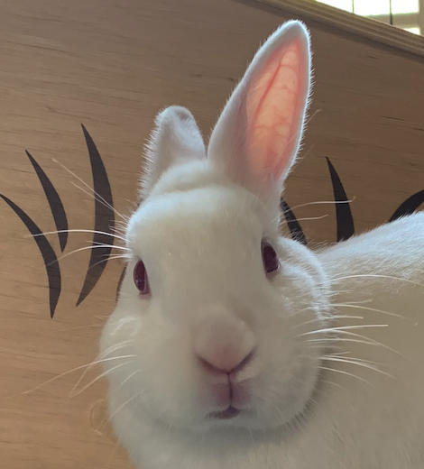
You’re now all graphics programmers!
Awesome!

Slide 17
End review...

Slide 18
How do movies or games
animate?

Slide 19
Move to Center
* That’s not quite toy story, but it is a start…

Slide 20
Animation Loop
def main():
# setup
while True:
# update world
# pause
time.sleep(DELAY)

Slide 21
Animation Loop
def main():
# setup
while True:
# update world
# pause
time.sleep(DELAY)
Make all the variables you need.

Slide 22
Animation Loop
def main():
# setup
while True:
# update world
# pause
time.sleep(DELAY)
The animation loop is a repetition of heartbeats

Slide 23
Animation Loop
def main():
# setup
while True:
# update world
# pause
time.sleep(DELAY)
Each heart-beat, update the world forward one frame

Slide 24
Animation Loop
def main():
# setup
while True:
# update world
# pause
time.sleep(DELAY)
If you don’t pause, humans won’t be able to see it

Slide 25
Move To Center
def main():
# setup
canvas = Canvas(CANVAS_WIDTH, CANVAS_HEIGHT)
r = canvas.create_rectangle(0, 0, 100, 100)
while not is_past_center(canvas, r):
# update world
canvas.move(r, 1, 0)
canvas.update()
# pause
time.sleep(DELAY)

Slide 26
We are ready…

Slide 27
Bouncing Ball

Slide 28
Milestone #1

Slide 29
Bouncing Ball
First heartbeat
Key variable: how much the ball position
change each heartbeat?

Slide 30
Bouncing Ball
First heartbeat
change_x
change_y
The move function takes in
a change in x and a change in y

Slide 31
Bouncing Ball
Second heartbeat
change_x
change_y

Slide 32
Bouncing Ball
Third heartbeat
change_x
change_y

Slide 33
Bouncing Ball
What happens when we hit a wall?

Slide 34
Bouncing Ball
We have this velocity
change_x
change_y

Slide 35
Bouncing Ball
Our new velocity
change_y
change_x
When reflecting vertically: change_y = -change_y

Slide 36
Bouncing Ball
Seventh heartbeat
change_y
change_x

Slide 37
Bouncing Ball
Eighth heartbeat
change_y
change_x

Slide 38
Bouncing Ball
Ninth heartbeat
change_y
change_x

Slide 39
Bouncing Ball
We want this!

Slide 40
Bouncing Ball
This was our old velocity
change_y
change_x

Slide 41
Bouncing Ball
This is our new velocity
change_y
change_x
When reflecting horizontally: change_x = -change_x

Slide 42
Bouncing Ball
Tenth heartbeat
change_y
change_x
When reflecting horizontally: change_x = -change_x

Slide 43
Bouncing Ball

Slide 44
Hold up!
def make_ball(canvas):
Does this copy the canvas??!!
Variables are stored using a reference. Which is like a URL. The URL gets copied when you pass the variable

Slide 45
How do you share google docs?
Antelope Canyon Article
Key:
https://docs.google.com/document/d/1eBtnEilI3KHefFS-kSAOpXqeSXpbfTTMlmOgj6I9dvk/

Slide 46
def main():
canvas = Canvas(…)
make_ball(canvas)
def make_ball(canvas):
canvas.create_rectangle( … )
stack
heap
main

Slide 47
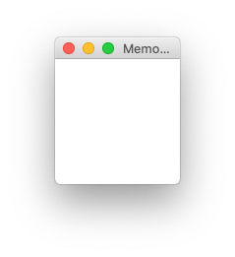
def main():
canvas = Canvas(…)
make_ball(canvas)
def make_ball(canvas):
canvas.create_oval( … )
stack
heap
memory.com/42
main
memory.com/42
canvas

Slide 48
def main():
canvas = Canvas(…)
make_ball(canvas)
def make_ball(canvas):
canvas.create_oval( … )
stack
heap
memory.com/42
main
canvas
42

Slide 49
def main():
canvas = Canvas(…)
make_ball(canvas)
def make_ball(canvas):
canvas.create_oval( … )
stack
heap
memory.com/42
main
canvas
42
make_ball
canvas

Slide 50
def main():
canvas = Canvas(…)
make_ball(canvas)
def make_ball(canvas):
canvas.create_oval( … )
stack
heap
memory.com/42
main
canvas
42
make_ball
canvas
42

Slide 51
def main():
canvas = Canvas(…)
make_ball(canvas)
def make_ball(canvas):
canvas.create_oval( … )
stack
heap
memory.com/42
main
canvas
42
make_ball
canvas
42

Slide 52
def main():
canvas = Canvas(…)
make_ball(canvas)
def make_ball(canvas):
canvas.create_oval( … )
stack
heap
memory.com/42
main
canvas
42
make_ball
canvas
42

Slide 53
def main():
canvas = Canvas(…)
make_ball(canvas)
def make_ball(canvas):
canvas.create_oval( … )
stack
heap
memory.com/42
main
canvas
42
make_ball
canvas
42

Slide 54
def main():
canvas = Canvas(…)
make_ball(canvas)
def make_ball(canvas):
canvas.create_oval( … )
stack
heap
memory.com/42
main
canvas
42

Slide 55
When passing variables, some act just like you are passing a URL.
That allows functions to modify the variable

Slide 56
Learning Goals
Feel more confident writing methods
Write animated programs

Slide 57
Special Graphics Functions
# move shape to some new coordinates
canvas.moveto(shape, new_x, new_y)
# move shape by a given change_x and change_y
canvas.move(shape, change_x, change_y)
Come back tomorrow to learn about lists!

Slide 59
A Sticky Situation
This is our new velocity
The ball is above the bottom, so we reverse its change_y
The ball is below the bottom, so we reverse its change_y

